Slide 1







Time Series Analysis
In Machine Learning
Presentation (Sec B)

Slide 2

01
What is Time Series
02
What is Time Series Analysis
03
Importance of Time Series Data
Overview
04
Components of Time Series
05
Modeling Techniques
06
Forecasting & Anomalies Detection

Slide 3
07
Real-life Applications
08
Advantages
Overview
09
Challenges and Limitations
10
Future Trends
11
Conclusion

Slide 4
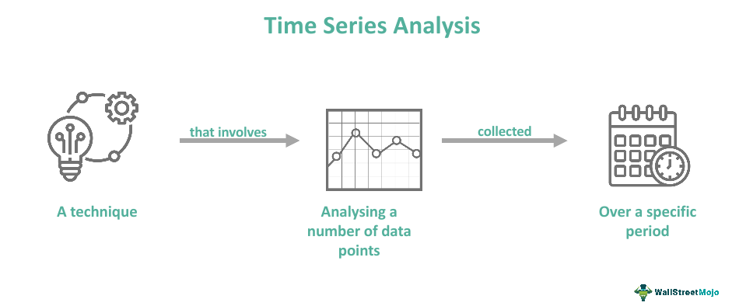
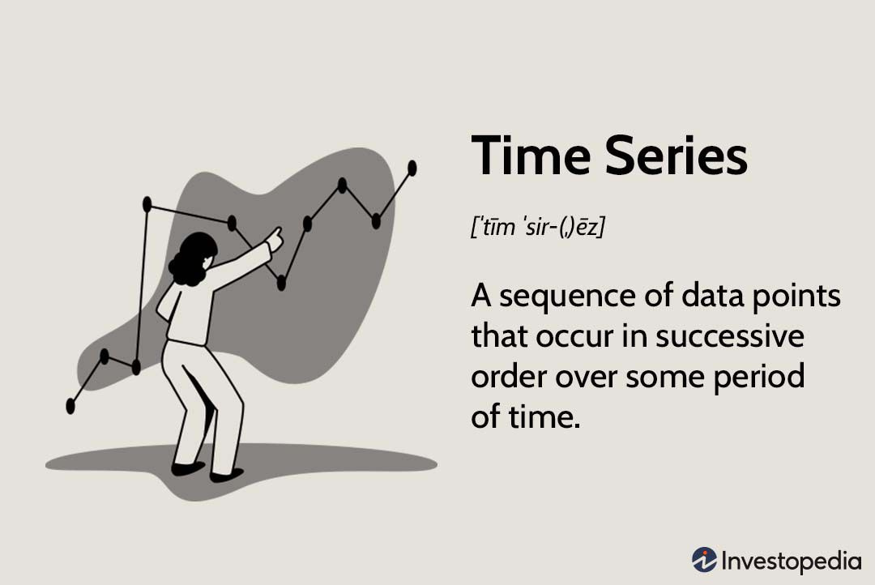
01
What is Time Series ?
A time series is a set of observation taken at specified times, usually at ‘equal intervals’. Mathematically a time series is defined by the values Y1, Y2…of a variable Y at times t1, t2…. Thus,
Y= F(t)

Slide 5
02
What is Time Series Data ?
Time series data is a collection of observations or data points recorded at equally spaced time intervals, typically in chronological order.
Each data point is associated with a timestamp, indicating when the observation was made.
Time series data is characterized by its temporal dependency, as each observation's value can depend on previous and/or future observations in the sequence.
Formal Definition: A time series data is the set of measurements taking place in a constant interval of time, here time acts as independent variable and the objective ( to study changes in a characteristics) is dependent variables.
For example
Consumption of energy per hour
Sales on daily basis
Company's profits per quarter
Annual changes in a population of a country

Slide 6
What is Time Series Analysis ?
03
"Time series analysis is a statistical technique dealing in time series data, or trend analysis."
Since social and economic conditions are constantly changing over time, data analysts must be able to assess and predict the effects of these changes, in-order to suggest the most appropriate actions to take. It’s therefore required to use appropriate forecasting techniques to support technology, business, operations, research, etc.

Slide 7
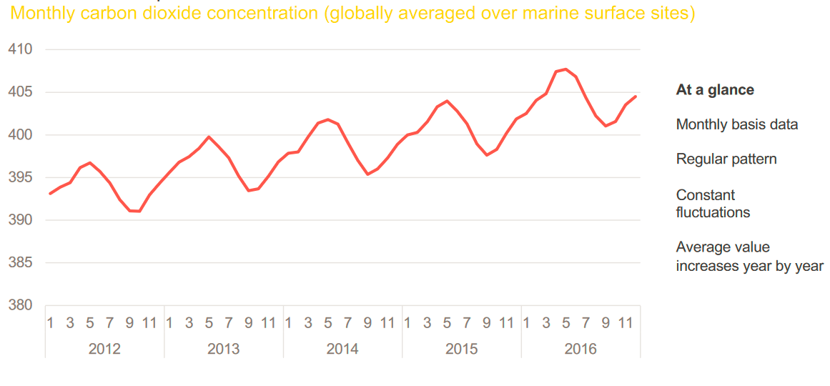
04
Example

Slide 8

05
Data Types
Time Series Data
A set of observations contains values, taken by variable at different times.
One single object observed over multiple equally-spaced
time periods
It focuses on results gained over an extended period of time
Examples: quarterly GDP of the last 10 years, weekly supermarket sales of the previous year, hourly temperature measurements for last one week
Cross-sectional data
Data values of one or more variables are gathered at the same time-point.
Multiple objects observed at a particular point of time
It focuses on information received from surveys and opinions at a particular time
Examples: customers’ behavioral data at today’s update, companies’ account balances at the end of the last year, patients’ medical records at the end of the current month
01
02

Slide 9
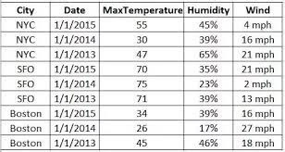
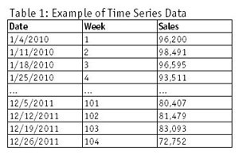
06
Example

Slide 10
Importance of Time Series Data
07
Pattern Recognition: Time series analysis helps in identifying recurring patterns, trends, and seasonal variations in data. This information can be used to make informed decisions, optimize processes, and adjust strategies accordingly.
01
02
Predictive Modeling: Time series analysis allows us to build predictive models that can forecast future values or trends based on historical data.
03
Environmental Monitoring: Time series analysis is used in monitoring environmental factors such as air and water quality, weather patterns, and climate change. It aids in understanding long-term trends and taking proactive measures.
Healthcare and Medicine: Time series analysis is employed to monitor and analyze patient data over time, enabling early disease detection, treatment optimization, and personalized medicine
Quality Control: In manufacturing and quality control processes, time series analysis can be used to monitor and maintain product quality by identifying deviations from expected standards in real time.
04
05

Slide 11

08
Components of Time Series
Trend
Cycle
Seasonality
Residual
The general tendency of the data to grow or decline over a long period of time.
Long-term fluctuations that occur regularly in
the series
Short-term fluctuations that occur regularly –
often associated with months or quarters
Whatever remains after the other components
have been taken into account

Slide 12
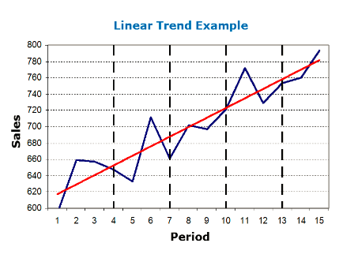
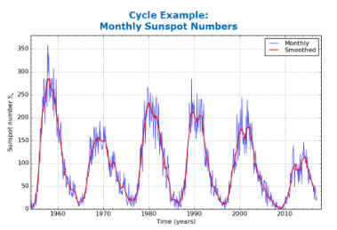
09
Components of Time Series
Secular Trend/Trend
Cyclic Variation/Cycle
The general direction in which the series
is running during a long period
A TREND exists when there is a long-term
increase or decrease in the data.
It does not have to be necessarily linear
(could be exponential or others functional
form)
A CYCLE is an oscillatory
component (i.e. Upward or Downward
swings) which is repeated after a certain
number of years, so:
May vary in length and usually lasts several
years (from 2 up to 20/30)
Difficult to detect, because it is often
confused with the trend component.

Slide 13
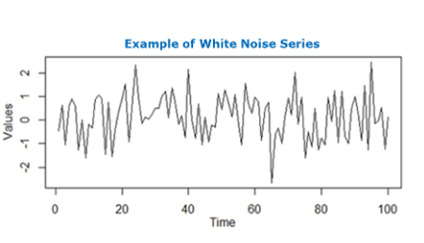
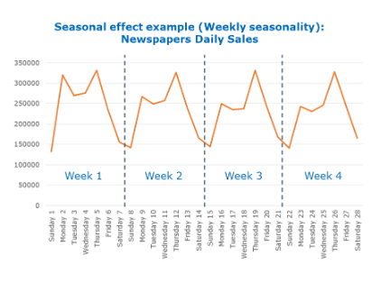
10
Components of Time Series
Seasonality
Residual/Noise
A SEASONAL PATTERN exists when a
series is influenced by seasonal factors (e.g., the quarter of the year, the month, day of the week). Seasonality is always of a fixed and known period. There is additive seasonality where components are independent of each other and multiplicative seasonality with dependent components.
The residual/error component is everything
that is not considered in previous components.
The difference between the actual value of the time series and the forecasted value is called Residual.Typically, it is assumed to be the sum of a set
of random factors (e.g. a white noise series)
not relevant for describing the dynamics of the series

Slide 14

11
The rise and fall of a time series over periods longer than one year is called:
(a) Secular trend
(b) Seasonality
(c) Cyclic variation
(d) Irregular variation
Quiz Time!

Slide 15
12
Time Series Analysis Modeling Techniques
Exponential Smoothing
ARIMA(Auto-Regressive Integrated Moving- Average)
Prophet
Machine Learning Models(LSTM, GRU)
Ensemble Method

Slide 16
13
Time Series Analysis Modeling Techniques
Exponential Smoothing
Exponential smoothing is a statistical method that models a variable's value as an exponentially weighted linear function of previous values. This approach assumes that recent observations have a more significant impact on future values and, therefore, assigns more weight to recent data points while forecasting.
Use: For short-term trend, Demand forecasting

Slide 17
14
Time Series Analysis Modeling Techniques
2. ARIMA(Auto-Regressive Integrated Moving-Average)
ARIMA is a comprehensive time series modeling technique that combines three key elements: Autoregressive (AR) terms, differencing (I), and Moving Average (MA) terms. ARIMA models are capable of handling various time series patterns, including trends and seasonality.
Use: For Finance, Economics & Forecasting

Slide 18
15
Time Series Analysis Modeling Techniques
3. Prophet
Prophet is a forecasting tool developed by Facebook that is user-friendly and capable of handling seasonality and outliers. It uses a decomposable time series model with components for trend, seasonality, and an error term.
Use: For Business forecasting

Slide 19
16
Time Series Analysis Modeling Techniques
4. Machine Learning Model( LSTM & GRU)
Machine learning models, such as Long Short-Term Memory (LSTM) and Gated Recurrent Unit (GRU), are part of the deep learning family. These models are designed to capture complex temporal dependencies in data and can be used for time series forecasting tasks.
Use: For sequential data like natural language text, sensor data

Slide 20
17
Time Series Analysis Modeling Techniques
5. Ensemble Method
Ensemble methods involve combining multiple forecasting models to improve overall accuracy and reduce the risk of overfitting. Techniques like bagging, boosting, and stacking are commonly used.
Use: For enhancing the accuracy of prediction

Slide 21
18
Forecasting &
Anomalies Detection
When analyzing time series data, forecasting, and anomaly detection are essential components that play distinct roles in revealing valuable insights.

Slide 22
19
Forecasting &
Anomalies Detection
Forecasting
Key Concepts:
Forecasting involves predicting future values or trends based on historical time series data.
Time Series Data: Utilizes sequential data collected at regular intervals.
Methods: Employs techniques like exponential smoothing, ARIMA models, machine learning algorithms

Slide 23
20
Forecasting &
Anomalies Detection
Anomalies Detection
Key Concepts:
Anomaly detection identifies data points that significantly deviate from expected or normal behavior within a dataset
Ordinary vs. Anomalous Behavior: Distinguish between expected patterns and rare, unexpected deviations.
Methods: Machine learning, clustering, and decomposition techniques.

Slide 24
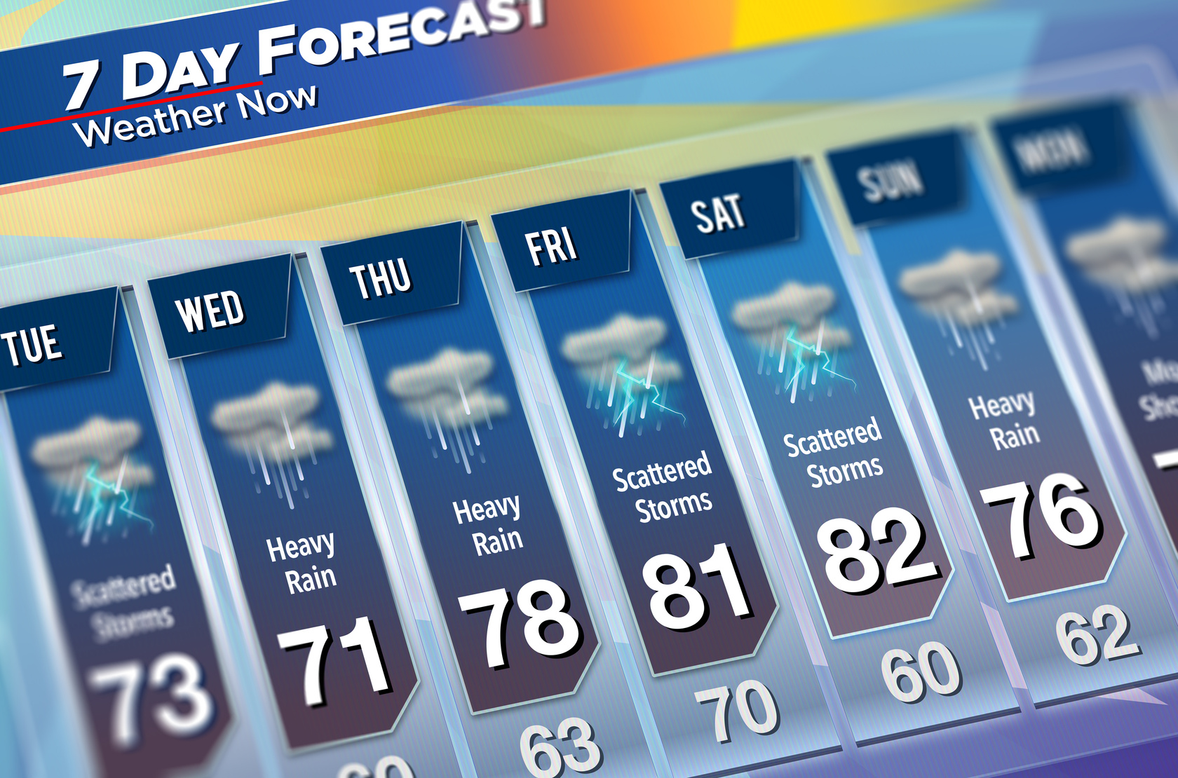
21
Real-life Applications of Time Series Analysis
Weather Forecasting
Application: Predicting temperature, precipitation, and weather patterns.
Meteorologists rely on time series data to issue weather forecasts, warnings, and climate studies.

Slide 25

22
Real-life Applications of Time Series Analysis
Financial Forecasting
Application: Predicting stock prices, currency exchange rates, or market indices.
Financial institutions and investors use time series analysis to make investment decisions and manage risk.

Slide 26

23
Real-life Applications of Time Series Analysis
Healthcare
Application: Monitoring patient health data and predicting disease outbreaks.
Hospitals and public health agencies use time series analysis for early disease detection and resource allocation.

Slide 27

24
Real-life Applications of Time Series Analysis
Network Anomaly
Application: Identifying unusual network traffic patterns.
IT and cybersecurity teams rely on this technology to detect network intrusions and potential security threats.

Slide 28

25
Real-life Applications of Time Series Analysis
Social Media & Sentiment Analysis
Application: Analyzing trends and sentiment on social media platforms
Businesses use time series data to understand customer opinions, track brand reputation, and adjust marketing strategies.

Slide 29

26
Real-life Applications of Time Series Analysis
Transportation & Traffic Forecasting
Application: Predicting traffic congestion and transportation patterns.
Transportation agencies use time series analysis to optimize routes, reduce congestion, and plan infrastructure improvements.

Slide 30

27
Real-life Applications of Time Series Analysis
Sports
Application: Performance analysis, opponent assessment.
Sports teams employ time series analysis to track player performance, predict injuries, and develop match strategies.

Slide 31
28
Advantages of Time Series Analysis
01. Predictive Power
02. Pattern Recognition
Time series analysis allows for the development of predictive models that can forecast future values based on historical data.
It enables the identification and extraction of complex temporal patterns and trends within the data.

Slide 32
29
Advantages of Time Series Analysis
04. Effective Policy and
Strategy Development
03. Anomaly Detection
Time series analysis can be employed for anomaly detection, helping to identify unusual or unexpected events in the data.
Time series analysis provides insights into the evolution of social, economic, and environmental variables

Slide 33
30
Advantages of Time Series Analysis
05. Risk Management
06. Adaptive Decision-Making
In financial markets, time series analysis is essential for assessing risk associated with different assets and portfolios
Time series analysis allows for adaptive strategies by continuously monitoring and responding to changing data patterns.

Slide 34
31
Challenges & Limitation
of Time Series Analysis
01. Noise and Outliers
02. Non-Stationarity
Time series data often contain noise and outliers that can significantly impact model accuracy
Modeling non-stationary data is challenging as traditional time series models assume stationarity.

Slide 35
32
Challenges & Limitation
of Time Series Analysis
03. Data Sparsity and
Missing Values
04. Overfitting
Overfitting occurs when a model captures noise or irrelevant patterns in the training data, resulting in poor performance on unseen data.
Time series data can suffer from missing values, irregular sampling intervals, or data gaps.

Slide 36
33
Challenges & Limitation
of Time Series Analysis
05. Limited Look-Ahead Accuracy
06. Data Quality Dependency
The accuracy and reliability of time series models heavily depend on the quality, consistency, and completeness of the input data.
Predicting too far into the future in time series analysis can result in less accurate forecasts.

Slide 37
34
Future Trends in
Time Series Analysis
Integration of Deep Learning for Time Series: Deep learning models, such as recurrent neural networks (RNNs), long short-term memory networks can capture intricate temporal dependencies and patterns, enhancing prediction accuracy.
01
Hybrid Models and Ensemble Learning: Combining the strengths of different models into hybrid models or leveraging ensemble learning techniques can potentially improve forecasting performance .
02
03
Integration of Domain Knowledge: Incorporating domain-specific knowledge into time series analysis will be crucial.

Slide 38
35
Future Trends in
Time Series Analysis
04
Automated Time Series Analysis: The future will likely witness the development of automated platforms and tools that can handle end-to-end time series analysis.
Handling Non-Traditional Data Types: Time series analysis will extend to diverse data types beyond traditional numerical time series, including text, image, and sensor data.
05
06
Time Series Anomaly Detection: Advanced anomaly detection techniques within time series data will be a growing trend.

Slide 39
36
Conclusion
Time Series Analysis is a powerful analytical technique that provides valuable insights into trends, patterns, and behaviors hidden within sequential data. Understanding and accurately predicting future values based on historical observations are vital for informed decision-making across a spectrum of industries and domains. Mastering Time Series Analysis equips us with the ability to harness the past to better anticipate the future.

Slide 40
01
https://www.quirks.com/articles/time-series-analysis-what-it-is-and-what-it-does
02
https://www.analyticssteps.com/blogs/introduction-time-series-analysis-time-series-forecasting-machine-learning-methods-models
03
https://www.series.net/time-series-analysis-82993562?fbclid=IwAR3aVPnUS7VhvNc8W_M3x4YS0mUkE3MDWg0H8uWxZdC97obh7H7vJQoKLMI
Reference
04
https://www.differencebetween.com/difference-between-time-series-and-cross-sectional-data/
05
https:///slide/13288329/?fbclid=IwAR0dPwR2ip5wlaz5vlYmEIbhWVYdUvosd6yxgd0vYA_uuW_RhdfNk_oFphU
06
https://www.toppr.com/guides/business-mathematics-and-statistics/time-series-analysis/components-of-time-series/.

Slide 41


Thank You

